Slide 1
Unit 3 – Simplification of Boolean Function

Slide 2
Different forms of Boolean Algebra
Sum of Product (SOP)
Product of Sum (POS)
SOP
Product Terms are summed together
Minimal SOP
Each product term consist of minimum numbers of variables.
E.g. XY+X’Y+XY’
Expanded SOP
Each product term consist of maximum numbers of variables.
E.g. XYZ+X’YZ+WXYZ

Slide 3
Different forms of Boolean Algebra (contd.)
POS
Sum terms are multiplied together
Minimal POS
Each sum term consist of minimum numbers of variables.
E.g. (X+Y) ٠ (X’+Y) ٠ (X+Y’)
Expanded POS
Each sum term consist of maximum numbers of variables.
E.g. (X+Y+Z)٠(X’+Y’+Z’)٠(W+X+Y+Z)

Slide 4
SOP | POS
A way of representing Boolean expressions as sum of product terms. | A way of representing Boolean expressions as product of sum terms.
SOP uses minterms. Minterm is product of Boolean variables either in normal form or complemented form. | POS uses maxterms. Maxterm is sum of Boolean variables either in normal form or complemented form.
Minterms are represented as ‘m’ | Maxterms are represented as ‘M’
SOP is formed by considering all the minterms, whose output is HIGH(1) | POS is formed by considering all the maxterms, whose output is LOW(0)
While writing minterms for SOP, input with value 1 is considered as the variable itself and input with value 0 is considered as complement of the input. | While writing maxterms for POS, input with value 1 is considered as the complement and input with value 0 is considered as the variable itself.

Slide 5
Canonical and Standard forms
Boolean functions expressed as a sum of minterms or product of maxterms are said to be in canonical form
In an expression in canonical form, every variable appears in every term
The two canonical forms of Boolean algebra are basic forms that one obtain from reading a function from the truth table
These forms are very seldom the ones with least number of literals, because each min-term or max-term must contain, by definition, all the variables either complemented or uncomplemented

Slide 6
Minterms or standard product
Each row of a truth table can be associated with a min-term, which is a product (AND) of all variables in the function, in direct or complemented form
A function with n variables has 2n min-terms
A min-term has the property that it is equal to 1 on exactly one row of the truth table
If it misses one or more variables, it is ANDed with an expression such as x + x', where x is one of the missing variables.

Slide 7
Maxterms or standard sums
Each row of a truth table is also associated with a max-term, which is a sum (OR) of all the variables in the function, in direct or complemented form
A function with n variables has 2n max-terms
A max-term has the property that it is equal to 0 on exactly one row of the truth table
If it misses one or more variables, this may be done by using the distributive law, x + yz = (x + y)(x + z). Then any missing variable x in each OR term is ORed with xx'.

Slide 8
Identifying min and max terms
No . | x | y | z | F
0 | 0 | 0 | 0 | 0
1 | 0 | 0 | 1 | 0
2 | 0 | 1 | 0 | 0
3 | 0 | 1 | 1 | 1
4 | 1 | 0 | 0 | 1
5 | 1 | 0 | 1 | 1
6 | 1 | 1 | 0 | 1
7 | 1 | 1 | 1 | 1
Min terms: 3,4,5,6,7
Max terms: 0,1,2
For Min terms: m3+m4+m5+m6+m7
∑ (x,y,z) or ∑ (3,4,5,6,7) = x’yz + xy’z’ + xy’z + xyz’ + xyz
For Max terms: M0 . M1 . M2
∏ (x,y,z) or ∏ (0,1,2) = (x+y+z) . (x+y+z’) . (x+y’+z)

Slide 9
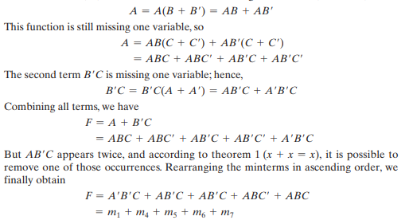
Example
Express the Boolean function F = A + BC as a sum of minterms
The function has three variables: A, B, and C. The first term A is missing two variables; therefore,

Slide 10
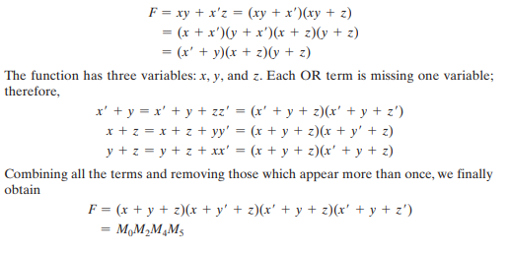
Example
Express the Boolean function F = xy + x’z as a product of max-terms
First, convert the function into OR terms by using the distributive law

Slide 11
Practice – Both SOP and POS
(a+b) (ab+ac)
(a+b’c) c
∑(0,1,5)
∏ (2,5,7,8)

Slide 12
Conversion between Canonical Forms
The max-term with subscript j is a complement of the min-term with the same subscript j and vice versa
m_{j}’= M_{j}
Example: Consider the function F(A, B, C) = ∑(1, 4, 5, 6, 7)

Slide 13
Example: F(A, B, C) = ∑(1, 4, 5, 6, 7)
Taking the complement of 𝐹 𝐹 ′(𝐴, 𝐵, 𝐶) = ∑(0, 2, 3) = 𝑚0 + 𝑚2 + 𝑚3
Taking the complement of 𝐹 ′ by DeMorgan’s theorem, we obtain F in a different form: 𝐹 = (𝑚0 + 𝑚2 + 𝑚3 )′ = 𝑚0 ′ ∙ 𝑚2 ′ ∙ 𝑚3 ′ = 𝑀0𝑀2𝑀3 = ∏(0, 2, 3)
Similarly, 𝐹(𝑥, 𝑦, 𝑧) = ∑(1, 3, 6,7) ⟷ 𝐹(𝑥, 𝑦, 𝑧) = ∏(0, 2, 4,5)

Slide 14
Karnaugh Map (K-Map)
Technique used for simplifying the Boolean expressions
It is a graphical representation of simplification of the Boolean expressions
For a Boolean expression with “n” numbers of variables, then number of cells required in K-Map = 2^{n} cells
Karnaugh map can produce Sum of product (SOP) or product of Sum(POS) expression

Slide 15
Rules of minimization in K-Map
While grouping, you can make groups of 2n number where n=0, 1, 2, 3…
You can either make groups of 1’s or 0’s but not both
Grouping of 1’s lead to Sum of Product form and Grouping of 0’s lead to Product of Sum form
While grouping, the groups of 1’s should not contain any 0 and the group of 0’s should not contain any 1
The function output for 0’s grouping should be complemented as 𝐹′.

Slide 16
Rules of grouping in K-Map
No Zero allowed
Group can be vertical or horizontal but not diagonal
Overlapping is allowed
Group should be as large as possible
Group must contains 2^{n} cells

Slide 17
Two variable K-Map
0 1
0
1
00 | 01
10 | 11

Slide 18
Example
Q. Simplify the Boolean function 𝑭 = 𝒙 ′𝒚 + 𝒙𝒚 ′ + 𝒙𝒚 using K-Map for min term

Slide 19
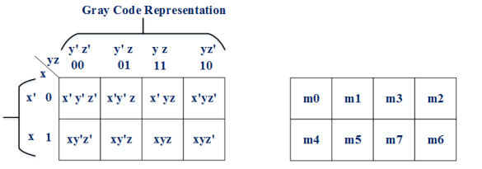
Three Variable K-Map

Slide 20
Examples
𝑭 = 𝑿 ′𝒀𝒁 + 𝑿𝒀 ′𝒁 ′ + 𝑿𝒀𝒁 + 𝑿𝒀𝒁′
F(A,B) = ∑(0,2,3)
𝑭(𝑾, 𝑿, 𝒀, 𝒁) = ∑(𝟎, 𝟏, 𝟐, 𝟒, 𝟓, 𝟔, 𝟖, 𝟗, 𝟏𝟐, 𝟏𝟑, 𝟏𝟒)

